Slide 1
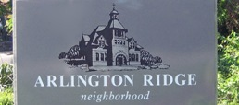
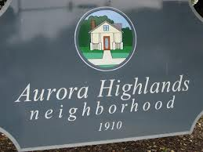
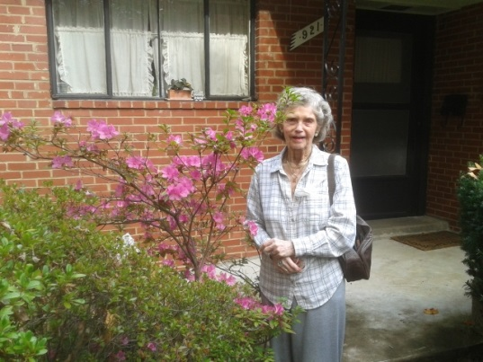
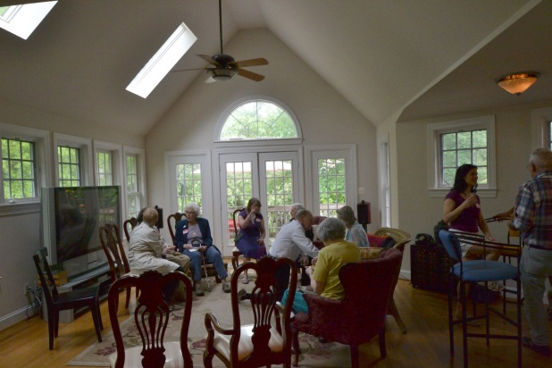
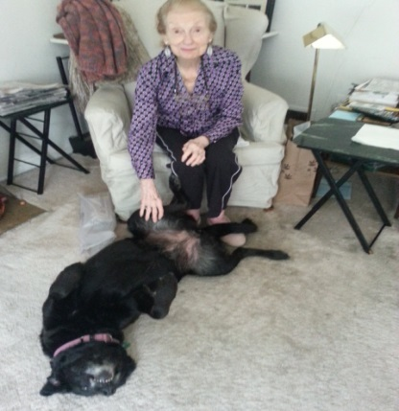
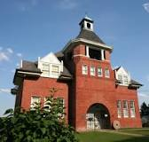
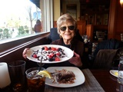
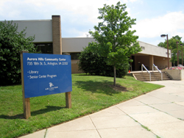
22202 Neighbors United (22202 NU)
ARCA Presentation - July 17, 2014

Slide 2
BACKGROUND
Nearly 200 "Villages" in 39 states and 4 countries
Since the early 2000s, Villages have emerged as an innovative model to help people remain in their homes and to connect with their communities throughout later life.
Villages have been defined as self-governing, grassroots, community-based organizations that coordinate access to a variety of supportive services to promote aging in place, social integration, health, and well-being.
Villages can be either fee-charging (e.g., Capitol Hill) or voluntary (e.g., Bethesda) – about 50/50 in DC Metro area
22202 NU is one of almost 50 villages in the DC metro area - Washington Area Village Exchange (WAVE)
Arlington Neighborhood Villages (ANV)
Our neighborhood was initially to be an ANV pilot but isn’t because ANV model is fee-charging, 22202 NU is not
In future, 22202 NU may merge with the broader ANV effort

Slide 3
Demographics
Description | Arlington Ridge |  |  | Aurora Highlands
 | # | % |  | # | %
Total Population | 6,324 | 33.2% |  | 8,725 | 45.7%
Age Distribution | # | % |  | # | %
Under 5 years | 225 | 3.6% |  | 387 | 4.4%
5 to 17 years | 385 | 6.1% |  | 371 | 4.3%
18 to 24 years | 511 | 8.1% |  | 917 | 10.5%
25 to 34 years | 1,836 | 29.0% |  | 3,152 | 36.1%
35 to 44 years | 943 | 14.9% |  | 1,321 | 15.1%
45 to 54 years | 720 | 11.4% |  | 928 | 10.6%
 | 4,620 | 73.1% |  | 7,076 | 81.1%
55 to 64 years | 792 | 12.5% |  | 730 | 8.4%
65 to 74 years | 506 | 8.0% |  | 461 | 5.3%
75 to 84 years | 280 | 4.4% |  | 288 | 3.3%
85 years and over | 126 | 2.0% |  | 170 | 1.9%
 | 1,704 | 26.9% |  | 1,649 | 18.9%
Additional details may be found on the Arlington County website:
http://www.arlingtonva.us/departments/CPHD/planning/data_maps/Census/2010Census/civic/page82974.aspx
The data is derived from the 2010 census.

Slide 4
KEY 22202 NU PRINCIPLES
Neighbors helping neighbors enhance and extend a useful quality of life in their own homes
Supporting from the heart: All volunteer
Reciprocity of services - Respect our neighbors for the diverse contributions they can make and appreciate everyone’s talents and abilities (i.e., participants are encouraged to be both a service provider and service requester)
Inter-generational, inter-species

Slide 5
Services Requested (as of July 15, 2014)
124 Unique (not recurring) Requests (July 2013-July 2014)
Avg = approximately 2/week

Slide 6
Services NOT Provided
No high risk physical activities (e.g., climb tall ladder to change battery in ceiling fire detector)
No rides to emergency/urgent care (call 911)
No in-home care-giving
No patient advocacy

Slide 7
Participants
Number of Unique Service Requests: 124 (not including recurring originating from 1 request, and not including informal neighbor follow-on requests/offers of assistance)
Number of Service Requesters: 27 (some are multiple requesters)
Number of Active Volunteers: 83 (those providing services)
Number of Participants (e.g., both on mailing list & providing/receiving services; on average, 1-2 new participants are added per week): 165
Participant Diversity: Men, women, children, and animals of all ages!

Slide 8
Challenges
Participants predominantly want to provide, not receive, support from neighbors
Support model unsustainable in long term
Eventually need more robust infrastructure and professionally trained staff (e.g., central call center; full-time or multiple coordinators; volunteer vetting, training; IT support for website/database)
Costs being borne by individuals, not organization (e.g., brochures; database/application development; association dues)
Non-profit organization not in place – any revenue applied directly to entity providing service (e.g., web hosting)
Liability insurance not in place (though mitigated by “non-sueable entities” concept)
Privacy concerns limits web-enabled tools for efficiency

Slide 9
What Can You Do?
Volunteer to receive/provide services
Outreach
Share info on 22202 NU with others in neighborhood (e.g., brochure/newsletter distribution; through churches or other venues)
Host/coordinate open houses, living room chats/get-acquainted/outreach block parties
Administrative and IT support

Slide 10
Contact Information
Linc Cummings (External Outreach) Email: Linc@cummingsleeds.com Phone: 703.548.2611
Diane Litman (Internal Coordination) Email: litmandc@gmail.com Phone: 703.498.9798

